Slide 1
Who am I?
I live in South America in the Andes Mountains
I like to eat grass and other plants making me a herbivore
My wool is used to make clothing, rugs, and ropes

Slide 2
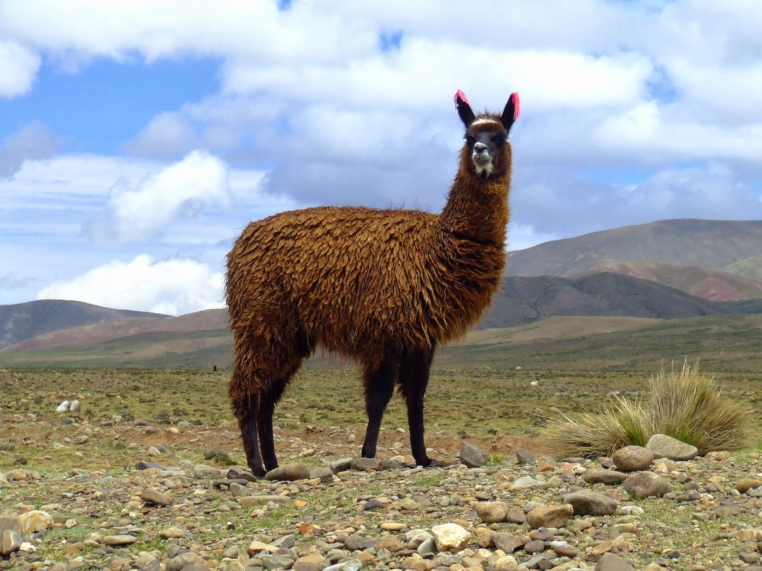

Slide 3
Who am I?
My horns are long and curved that are used to fight
You can find me on rocky areas making it difficult for predators to find me
I like to eat plants making me a herbivore

Slide 4
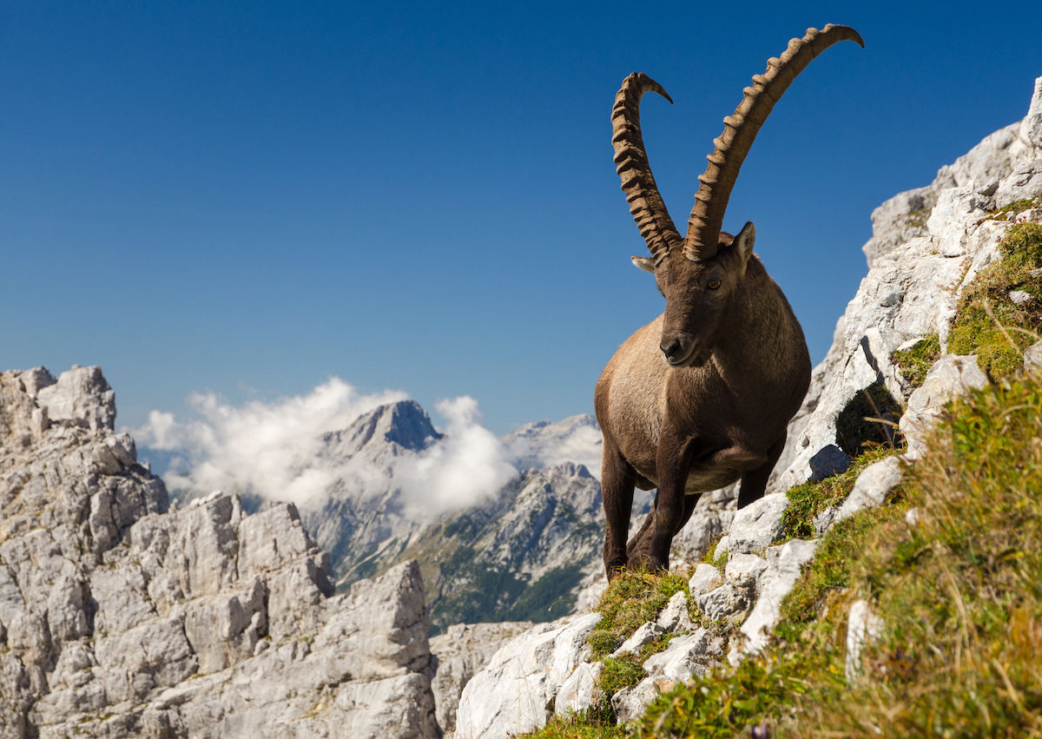

Slide 5
Who am I?
I have powerful feet and sharp talons
I prefer to live in open areas in the mountains
My beak helps me eat meat

Slide 6
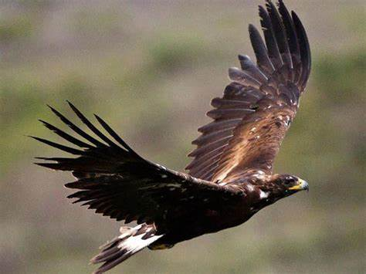

Slide 7
Who am I?
My fur helps me adapt to the cold
My fur helps me blend in with my surroundings
I like to eat wild sheep and goats

Slide 8
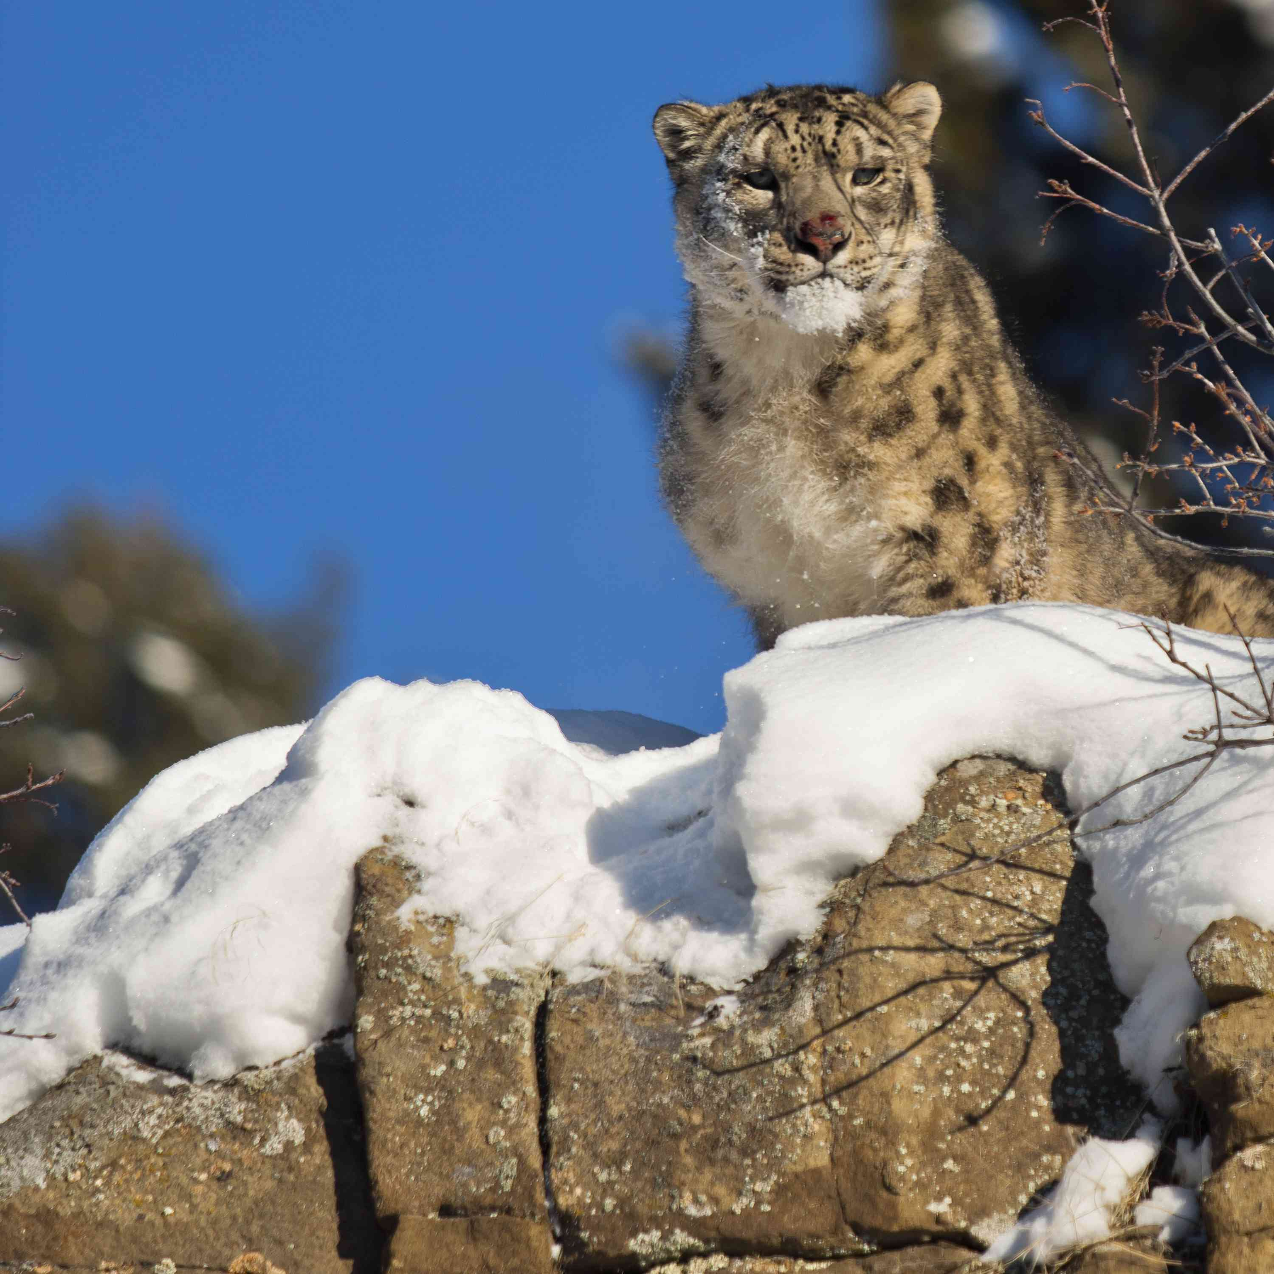

Slide 9
Who am I?
I produce milk all year round similar to cows
I eat herbs and grass which makes me a herbivore
I am from the Himalayan region

Slide 10
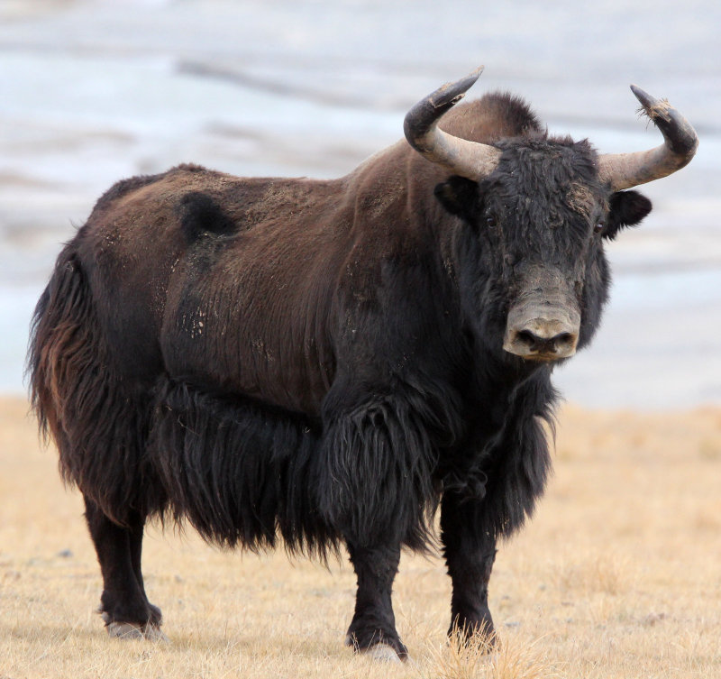

Slide 11
Who am I?
You can find me in the Andes in South America
I prefer to live in windy areas
I like to eat animal carcasses

Slide 12
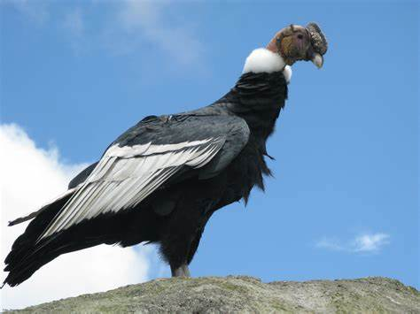

Slide 13
Who am I?
I protect my young for the first month of their lives
My fur helps me camouflage in my habitat
You can find me in China
I enjoy eating bamboo

Slide 14
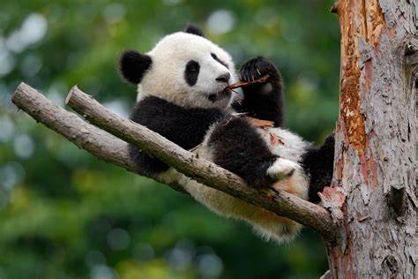

Slide 15
Who am I?
I eat other mammals which makes me a carnivore
I live in many different habitats in North and South America
I have a poor sense of smell, but I can see very well

Slide 16
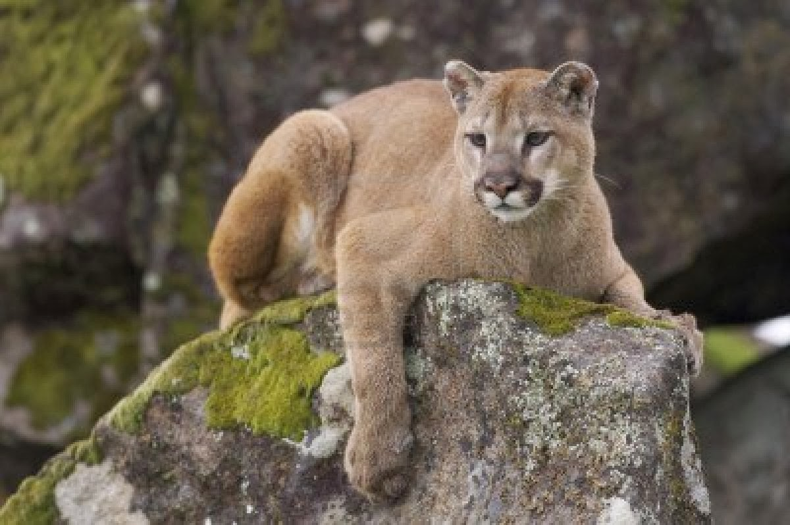

Slide 17
Who am I?
I live in large flocks
I graze on grass on shrubs
You can find me in the alpine meadows, on the grass, and on rocky cliffs

Slide 18
